Slide 1

Sales Data Analysis Case Study
Aravind N

Slide 2
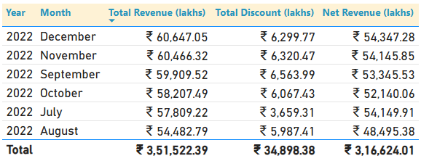
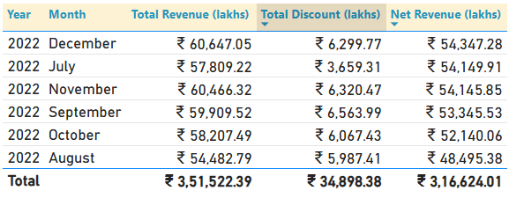
Overview
Data covers 6 months: July 2022 to December 2022
Total revenue: ₹3,51,522 lakhs
December 2022 contributed the highest revenue
Discounts offered: ₹34,898 lakhs → Net revenue: ₹3,16,624 lakhs
July 2022: Lower revenue, but higher net revenue than September, October, and November (due to fewer discounts)
August 2022: Highest discount percentage across all months
Type 4 SKUs: Contributed 94% of total revenue
Sorted by Revenue
Sorted by Net Revenue

Slide 3
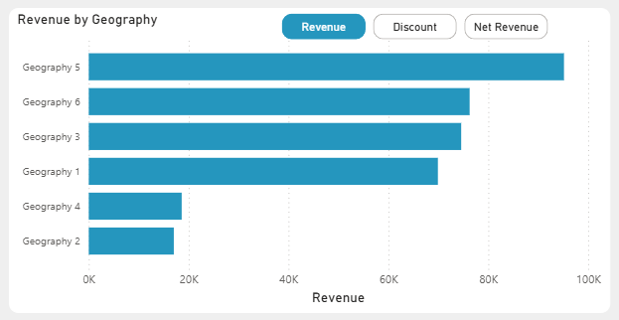
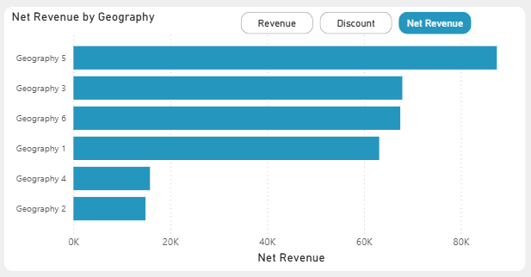
Geography Analysis
The top performing geography is Geography 5
The descending order of geographies in terms of revenue 5,6,3,1,4,2
But in terms of net revenue 5,3,6,1,4,2 because Geography 6 offered the most discounts overall & each month.
The order of geographies remains same for overall & monthly

Slide 4
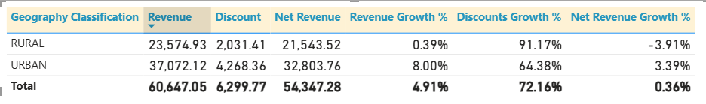
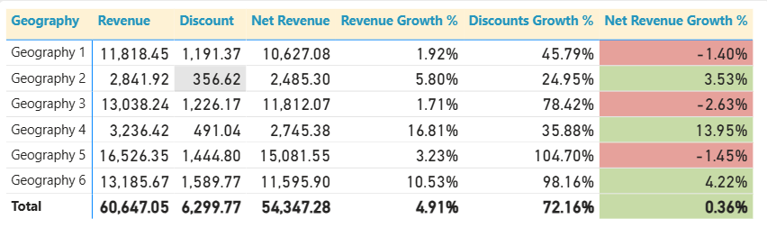
Geography Analysis
From Jul to Dec 22’ the stores from rural areas experienced a dip in net revenue (-4%) whereas urban stores shown a growth (+3.4%)
Geographies 1 (-1.4%),3 (-2.7%) & 5 (-1.4%) experienced a dip in net revenue, but rest of the geographies, 2 (+3.5%),4 (+14%) & 6 (+4.2%) shown a growth

Slide 5
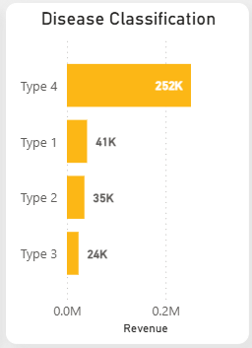
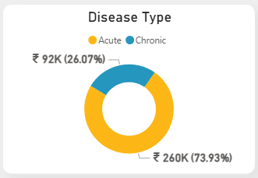
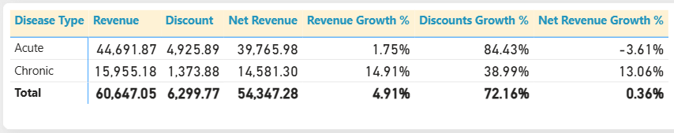
Disease Analysis
Acute disease type has the most contribution ~75% of the total revenue
Type 4 tops the chart with significant contribution of ~72% of the total revenue
All type 2 diseases are chronic
From Jul to Dec 22’ the acute disease type experienced a dip in net revenue (-3.6%) whereas chronic diseases shown significant growth (+13%)

Slide 6
Steps Performed
Checked if the data needed cleaning
Connected the data to Power BI
Analyzed the data to understand key patterns and trends
Brainstormed possible narratives and actionable insights
User Personas:
  Business Heads
  Operations Managers
  Leaders managing multiple geographies or stores
  Product Marketing Managers
Challenges Faced
Balancing detailed data findings with a proper business story required iteration
How I Overcame It
  I validated my narrative by discussing with peers in my network, which helped me refine the storyline to suit multiple stakeholders

Slide 7
Thank You!
Please feel free to write your feedback at nallajerlaaravind036@gmail.com

